Slide 1
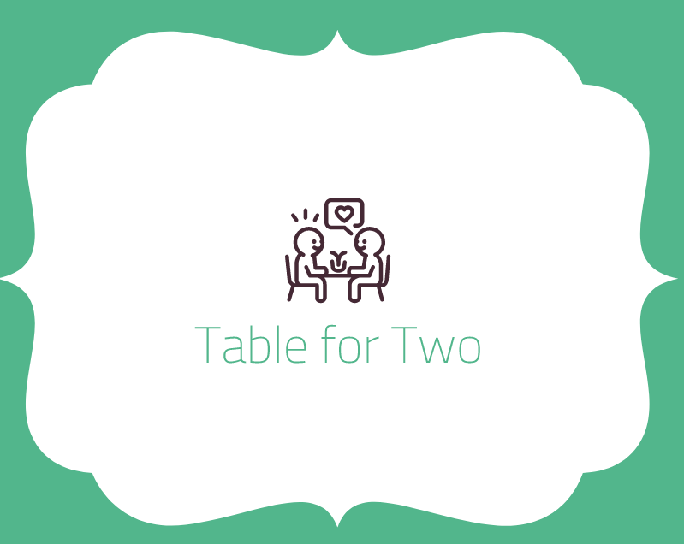

Slide 2
Menu
Out of 3 - Easy….................................. - Medium…………………………… - Hard…………………………………
Out of 5 - Easy….................................. - Medium…………………………… - Hard………………………………..
Player 1 - Choose colour
Player 2 - Choose colour
Players have to choose out of how many rounds to play and what difficulty
Depending on the difficulty and play mode, 2 meals (identical in quantity) will be chosen and this is what player 1 and player 2 will cater to

Slide 3
Cutscene
Comic
To show that people have lost interest in each other (people on phones, ignoring partner)
Food is the way to people’s hearts
Restaurant run by cats – setting
Head Chef cat is awesome but has gone to the vets (inspirational poster of Head chef cat)
Its up to the little chef’s to run the business and be the best to become executive Chef
Winner- Not only will people fall in love but winner become executive chef
Loser – Break up people and be in shame and despair

Slide 4
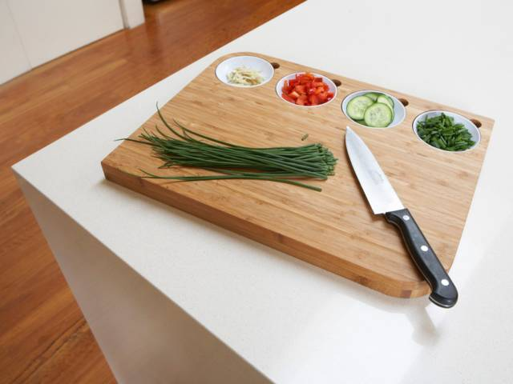
Food prep
The dishes are chosen - it would show the meal that should be made – the order list - e.g. Couple has ordered: Italian meal and beef meal
Food prep - Ingredients list are then shown – timed (depends on difficulty) - Timed - player has to gather ingredients – ingredients will gather on chopping board - at the bottom of screen, player will have to choose correct ingredients - Once they have gathered everything, they press the (cooking) button to continue.

Slide 5
Making the food
Time to cook! (also timed)
Show instructions (page ripped from cook book) - Dice onions tap4 -Whisk eggs Tap6
Depending on the action is how many taps to remember
After all is done, cooking transition
Screen pops up to say player 2 and shows the meal that player 2 will prep and cook

Slide 6
The results
We are testing player’s memory
Player 2 has ended their part
Drum roll to announce winner
Split screen
2 ideas
1. When

Slide 7
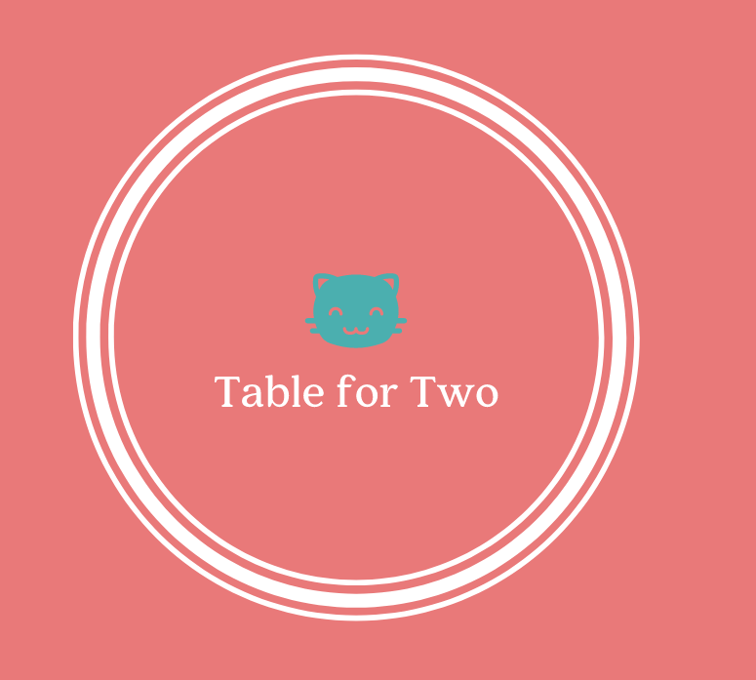
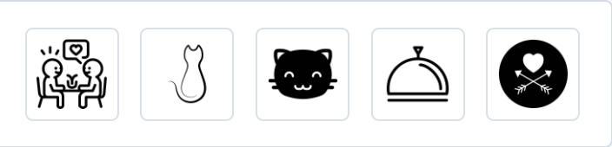
Logo styles

